Slide 1
Basic Web Development with HTML, CSS and JavaScript
Course Overview

Slide 2
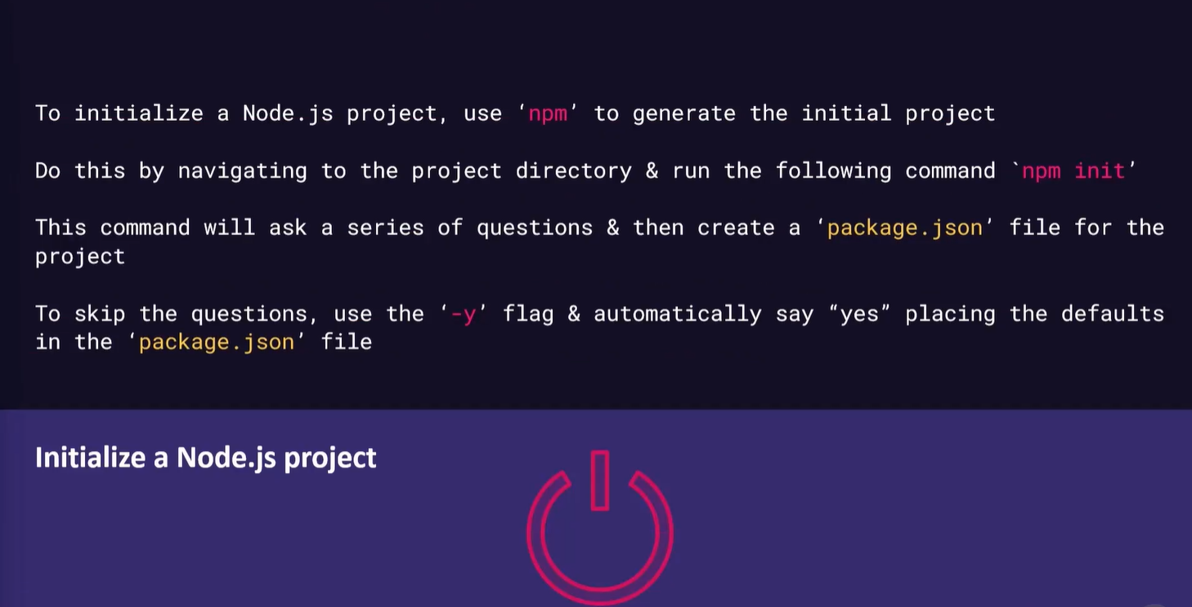

Slide 3
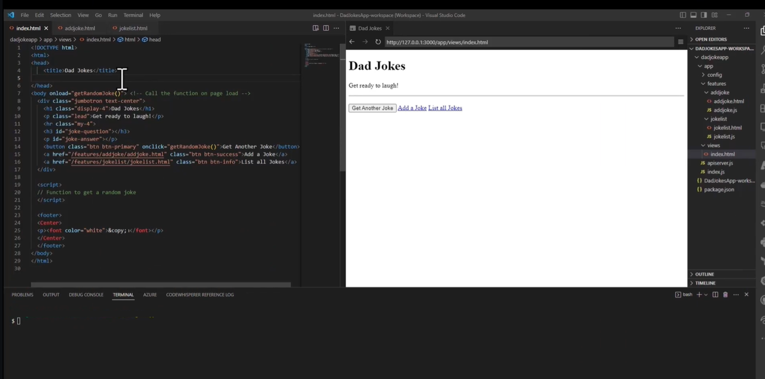

Slide 4
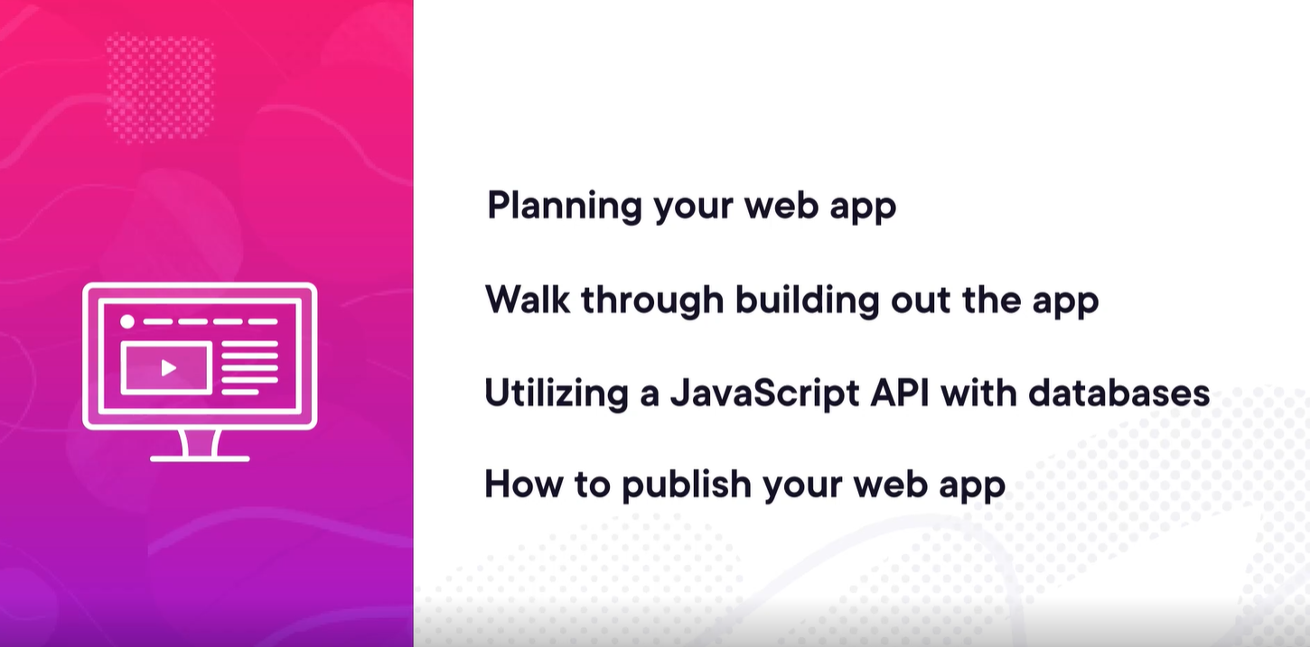

Slide 5


Slide 6
